Slide 1
527 Data Analytics
February 11th, 2016
Chicago Pothole Repair

Slide 2
Week 4 Topic: Chicago Pothole Repair Intro/Background
What are potholes?
Potholes are typically irregularly shaped pavement holes.
What causes potholes?
Potholes are caused by the freeze-thaw cycle. When moisture seeps into pavement, it expands when it freezes and contracts when it thaws. This flexing of the pavement, combined with the melted water and the stress of vehicular traffic, causes pavement to deteriorate and potholes to form.
What kind of material
How long does it take to fill a pothole?
Repairs are generally completed within 3-6 days.
Chicago Department of Transportation uses asphalt to fix potholes.
How Chicago Department of Transportation find potholes?
Chicago has a non-emergency services number, 311 and Chicago residents can call this number to report street surface potholes. According to 311 system, Chicago Department of Transportation forms a computerized mapping and tracking system to identify pothole locations and schedule crews.

Slide 3
Week 4 Topic: Chicago Pothole Repair Intro/Background
How Chicago Department of Transportation find potholes?
Chicago has a non-emergency services number, 311 and Chicago residents can call this number to report street surface potholes. According to 311 system, Chicago Department of Transportation forms a computerized mapping and tracking system to identify pothole locations and schedule crews.
Chicago is home to...
237 square miles of land
77 community areas containing more than 100 neighborhoods
CDOT crews repair potholes on 3,800 miles of streets in neighborhoods throughout the city all year long. The months of December through April are considered the heart of the pothole season--when the city typically sees the highest number of potholes. However, crews work throughout the spring, summer and fall as well.
CDOT uses several techniques that enable the department to fill hundreds of thousands of potholes each year . They include:
Computerized mapping and tracking of potholes reported to the City’s 311 system
Seven-day-a-week deployment of pothole repair crews during the winter months, including weekend crews and an overnight crew
The use of high-performance cold-patch asphalt material for pothole repairs during the winter months and hot mix asphalt in spring, summer and fall.

Slide 4
Week 4 Topic: Chicago Pothole Repair Intro/Background
List data used versus not. State reasons why
Include statistics on data files. For example:
Statistics for the download file:
Total # of rows in file: 154797
Total # of geographic regions (postal code) in dataset: 8
Total # of States in dataset: 36
Include relevant facts about the data. For example:
Postal Index Number (PIN) or PIN Code is a 6 digit code of Post Office numbering used by India Post. The PIN was introduced on August 15, 1972. There are 9 PIN regions in the country. The first 8 are geographical regions and the digit 9 is reserved for the Army Postal Service. The first digit indicates one of the regions. The first 2 digits together indicate the sub region or one of the postal circles. The first 3 digits together indicate a sorting / revenue district. The last 3 digits refer to the delivery Post Office.
Include any data issues
Include a map or pictorial description of the data
Gather relevant information outside of the data file to add context to the data file

Slide 5
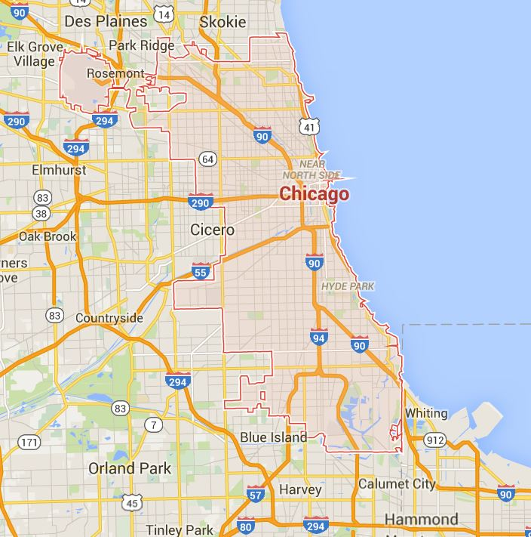
Week 4 Topic: Chicago Pothole Repair Intro/Background

Slide 6
Week 4 Topic: Chicago Pothole Repair Analysis
Follow the guidelines and include analysis with surrounding text
Answer questions on data.
Highlight relevant assumptions as needed to add context to analysis
Highlight derived data as necessary to complete the analysis
Add commentary on why certain analysis needs additional data – if that is the case

Slide 7
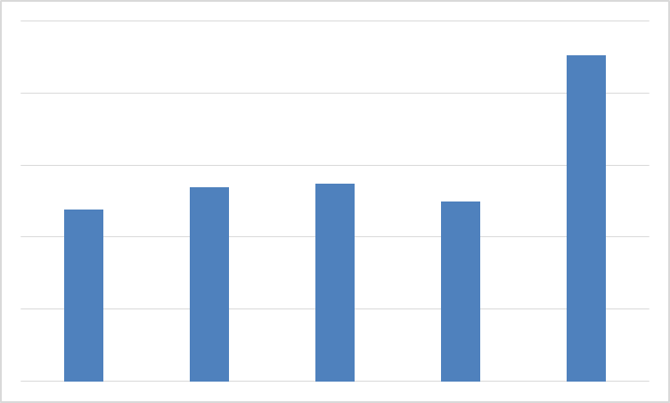
Week 4 Topic: Chicago Pothole Repair Analysis
$15,000K
$13,581KK
$12,000K
$9,000K
$8,070K
$8,232K
$7,161K
$7,466K
$6,000K
$3,000K
2011
2012
2013
2014
2015
Year

